Slide 1


The Hub Lectures 2024

Slide 2
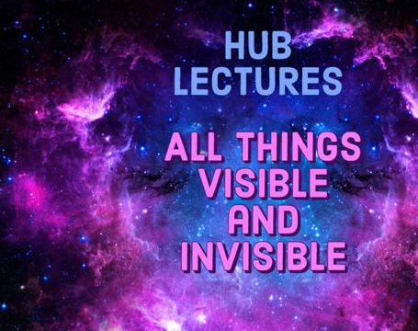
THE CREATION
STORY
Supernatural Worldview

Slide 3
SERIES ONE: All Things Visible & Invisible
Programme: Saturday 3 February 2pm – 5.30pm (GMT)
(Live from 1.30pm)
    Lecture 1. The Supernatural Worldview of the Bible
    (2.00pm – 2.50pm)
    Lecture 2. Creation of the Invisible World
      (3.00pm – 3.50pm)
    Lecture 3. Creation of the Visible World
    (4.10pm – 5.00pm)
    Q & A
    (5.00pm – 5.30pm)

Slide 4
PART ONE:
All things visible and invisible
  The Nicene Creed (Councils of Nicaea 325 & Constantinople 381)
  I believe in one God,
  the Father almighty,
  maker of heaven and earth,
  of all things visible and invisible.

Slide 5
PART ONE:
All things visible and invisible
Bible translators and expositors often fail to do full justice to the supernatural worldview of the Scriptures and their Ancient Near Eastern cultural context.

Slide 6
LECTURE 1:
The Supernatural Worldview of the Bible
Christianity is rooted in a supernatural worldview
  The existence of God
  Other doctrines that necessitate the existence of a supernatural reality:
    Angelology – the heavenly host, angels & demons, cherubim & seraphim, Satan, principalities and powers.

Slide 7
LECTURE 1:
The Supernatural Worldview of the Bible
The Bible and the ANE
We must begin by reading the Bible through the eyes of a 1st Century Jew, that is, within the context of a thoroughly biblical worldview.
Hard-to-understand or obscure passages suddenly begin to make sense.

Slide 8
LECTURE 1:
The Supernatural Worldview of the Bible
The Bible and the ANE
  The Nachash Gen 3;
  The Nephilim Gen 6:1-5;
  The Satan Job 1 & 2;
  The “gods” of Psalm 82; Psalm 89:5-18 (Hebrews 12:22);
  Other biblical imagery – heavenly host, nature, chaos imagery Psalm 68:4-18 (Matthew 16:18 & Ephesians 4:7-16); Psalm 135:1-15; Psalm 138:1-3; Isaiah 59:1 etc.
  References to “sons of god”: Genesis 6:1-5, Genesis 11:1-9; Deuteronomy 32:8-9,15-22; Psalm 82:1-8, cf. Psalm 89:5-8.

Slide 9
LECTURE 1:
The Supernatural Worldview of the Bible
The story of the Bible comes together – the plan of God, to redeem humanity and to unite his heavenly sons and his earthly sons into one big family in the new heavens and the new earth.

Slide 10
LECTURE TWO:
Creation of the Invisible World
CREATION OF THE INVISIBLE WORLD
  Genesis 1:1
In the beginning, God created the heavens and the earth. ESV

Slide 11
Christo van der Merwe, The Lexham Hebrew-English Interlinear Bible (Bellingham, WA: Lexham Press, 2004), Ge 1:1 (word order reversed):
בְּרֵאשִׁ֖ית |  | בָּרָ֣א |  | אֱלֹהִ֑ים |  | אֵ֥ת |  | הַשָּׁמַ֖יִם |  | וְאֵ֥ת |  | הָאָֽרֶץ׃
b^{e}rē(ʾ)·šîṯʹ |  | bā·rā(ʾ)ʹ |  | ʾ^{ě}lō·hîmʹ |  | ʾēṯʹ |  | hǎš·šā·mǎʹ·yim |  | w^{e}ʾēṯʹ |  | hā·ʾāʹ·rěṣ
בְּ · רֵאשִׁית |  | ברא |  | אֱלֹהִים |  | אֵת |  | הַ · שָׁמַ֫יִם |  | וְ · אֵת |  | הַ · אֶ֫רֶץ
b · rē(ʾ)·šîṯʹ |  | brʾ |  | ʾ^{ě}lō·hîmʹ |  | ʾēṯʹ |  | hǎʹ · šā·mǎʹ·yim |  | w · ʾēṯʹ |  | hǎʹ · ʾěʹ·rěṣ
in · beginning |  | createª |  | God |  | [obj] |  | the · heaven^{bc} |  | and · [obj] |  | the · earth
in · the beginning (of)¹ |  | (he) created |  | God |  | [obj] |  | the · heaven |  | and · [obj] |  | the · earth
P · NCFSA |  | VaP3MS |  | NCMPA |  | PO |  | A · NCMPA |  | C · PO |  | A · NC-SA

Slide 12
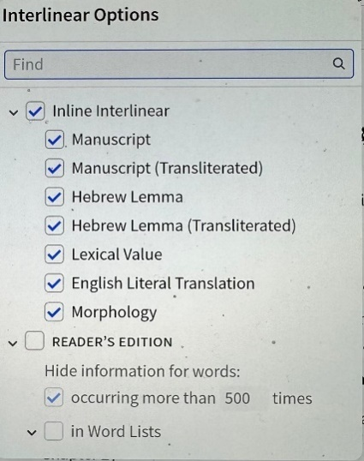
Christo van der Merwe, The Lexham Hebrew-English Interlinear Bible (Bellingham, WA: Lexham Press, 2004), Ge 1:1 (word order reversed):
בְּרֵאשִׁ֖ית |  | בָּרָ֣א |  | אֱלֹהִ֑ים |  | אֵ֥ת |  | הַשָּׁמַ֖יִם |  | וְאֵ֥ת |  | הָאָֽרֶץ׃
b^{e}rē(ʾ)·šîṯʹ |  | bā·rā(ʾ)ʹ |  | ʾ^{ě}lō·hîmʹ |  | ʾēṯʹ |  | hǎš·šā·mǎʹ·yim |  | w^{e}ʾēṯʹ |  | hā·ʾāʹ·rěṣ
בְּ · רֵאשִׁית |  | ברא |  | אֱלֹהִים |  | אֵת |  | הַ · שָׁמַ֫יִם |  | וְ · אֵת |  | הַ · אֶ֫רֶץ
b · rē(ʾ)·šîṯʹ |  | brʾ |  | ʾ^{ě}lō·hîmʹ |  | ʾēṯʹ |  | hǎʹ · šā·mǎʹ·yim |  | w · ʾēṯʹ |  | hǎʹ · ʾěʹ·rěṣ
in · beginning |  | createª |  | God |  | [obj] |  | the · heaven^{bc} |  | and · [obj] |  | the · earth
in · the beginning (of)¹ |  | (he) created |  | God |  | [obj] |  | the · heaven |  | and · [obj] |  | the · earth
P · NCFSA |  | VaP3MS |  | NCMPA |  | PO |  | A · NCMPA |  | C · PO |  | A · NC-SA

Slide 13
Christo van der Merwe, The Lexham Hebrew-English Interlinear Bible (Bellingham, WA: Lexham Press, 2004), Ge 1:1 (word order reversed):
בְּרֵאשִׁ֖ית |  | בָּרָ֣א |  | אֱלֹהִ֑ים |  | אֵ֥ת |  | הַשָּׁמַ֖יִם |  | וְאֵ֥ת |  | הָאָֽרֶץ׃
b^{e}rē(ʾ)·šîṯʹ |  | bā·rā(ʾ)ʹ |  | ʾ^{ě}lō·hîmʹ |  | ʾēṯʹ |  | hǎš·šā·mǎʹ·yim |  | w^{e}ʾēṯʹ |  | hā·ʾāʹ·rěṣ
בְּ · רֵאשִׁית |  | ברא |  | אֱלֹהִים |  | אֵת |  | הַ · שָׁמַ֫יִם |  | וְ · אֵת |  | הַ · אֶ֫רֶץ
b · rē(ʾ)·šîṯʹ |  | brʾ |  | ʾ^{ě}lō·hîmʹ |  | ʾēṯʹ |  | hǎʹ · šā·mǎʹ·yim |  | w · ʾēṯʹ |  | hǎʹ · ʾěʹ·rěṣ
in · beginning |  | createª |  | God |  | [obj] |  | the · heaven^{bc} |  | and · [obj] |  | the · earth
in · the beginning (of)¹ |  | (he) created |  | God |  | [obj] |  | the · heaven |  | and · [obj] |  | the · earth
P · NCFSA |  | VaP3MS |  | NCMPA |  | PO |  | A · NCMPA |  | C · PO |  | A · NC-SA
Example of morphology: bārā
“created” : Verb, Perfect tense, Masculine Singular

Slide 14
Christo van der Merwe, The Lexham Hebrew-English Interlinear Bible (Bellingham, WA: Lexham Press, 2004), Ge 1:1 (word order reversed):
בְּרֵאשִׁ֖ית |  | בָּרָ֣א |  | אֱלֹהִ֑ים |  | אֵ֥ת |  | הַשָּׁמַ֖יִם |  | וְאֵ֥ת |  | הָאָֽרֶץ׃
b^{e}rē(ʾ)·šîṯʹ |  | bā·rā(ʾ)ʹ |  | ʾ^{ě}lō·hîmʹ |  | ʾēṯʹ |  | hǎš·šā·mǎʹ·yim |  | w^{e}ʾēṯʹ |  | hā·ʾāʹ·rěṣ
בְּ · רֵאשִׁית |  | ברא |  | אֱלֹהִים |  | אֵת |  | הַ · שָׁמַ֫יִם |  | וְ · אֵת |  | הַ · אֶ֫רֶץ
b · rē(ʾ)·šîṯʹ |  | brʾ |  | ʾ^{ě}lō·hîmʹ |  | ʾēṯʹ |  | hǎʹ · šā·mǎʹ·yim |  | w · ʾēṯʹ |  | hǎʹ · ʾěʹ·rěṣ
in · beginning |  | createª |  | God |  | [obj] |  | the · heaven^{bc} |  | and · [obj] |  | the · earth
in · the beginning (of)¹ |  | (he) created |  | God |  | [obj] |  | the · heaven |  | and · [obj] |  | the · earth
P · NCFSA |  | VaP3MS |  | NCMPA |  | PO |  | A · NCMPA |  | C · PO |  | A · NC-SA

Slide 15
Christo van der Merwe, The Lexham Hebrew-English Interlinear Bible (Bellingham, WA: Lexham Press, 2004), Ge 1:1 (word order reversed):
בְּרֵאשִׁ֖ית |  | בָּרָ֣א |  | אֱלֹהִ֑ים |  | אֵ֥ת |  | הַשָּׁמַ֖יִם |  | וְאֵ֥ת |  | הָאָֽרֶץ׃
b^{e}rē(ʾ)·šîṯʹ |  | bā·rā(ʾ)ʹ |  | ʾ^{ě}lō·hîmʹ |  | ʾēṯʹ |  | hǎš·šā·mǎʹ·yim |  | w^{e}ʾēṯʹ |  | hā·ʾāʹ·rěṣ
בְּ · רֵאשִׁית |  | ברא |  | אֱלֹהִים |  | אֵת |  | הַ · שָׁמַ֫יִם |  | וְ · אֵת |  | הַ · אֶ֫רֶץ
b · rē(ʾ)·šîṯʹ |  | brʾ |  | ʾ^{ě}lō·hîmʹ |  | ʾēṯʹ |  | hǎʹ · šā·mǎʹ·yim |  | w · ʾēṯʹ |  | hǎʹ · ʾěʹ·rěṣ
in · beginning |  | createª |  | God |  | [obj] |  | the · heaven^{bc} |  | and · [obj] |  | the · earth
in · the beginning (of)¹ |  | (he) created |  | God |  | [obj] |  | the · heaven |  | and · [obj] |  | the · earth
P · NCFSA |  | VaP3MS |  | NCMPA |  | PO |  | A · NCMPA |  | C · PO |  | A · NC-SA

Slide 16
LECTURE TWO:
Creation of the Invisible World
CREATION OF THE INVISIBLE WORLD
Plural nouns in Genesis 1:1
אֱלֹהִים ʾ^{e}lōhîm (Plural Noun)
בָּרָא bārāʾ (3rd Person Masculine Singular)
(Elohim here refers to God and not to plural elohim).
הַ · שָׁמַ֫יִם hǎʹ · šā·mǎʹ·yim (Plural Tantum noun)
(Translated as “heaven” or “sky”. Later Judaism speculated on there being several layers or tiers of heavens).

Slide 17
LECTURE TWO:
Creation of the Invisible World
CREATION OF THE INVISIBLE WORLD
Spiritual beings existed prior to the creation of the earth
Job 38:4-7
⁴"Where were you when I laid the foundation of the earth? Tell me, if you have understanding. ⁵Who determined its measurements—surely you know! Or who stretched the line upon it? ⁶On what were its bases sunk, or who laid its cornerstone, ⁷when the morning stars sang together, and all the sons of God shouted for joy? ESV

Slide 18
LECTURE TWO:
Creation of the Invisible World
CREATION OF THE INVISIBLE WORLD
Spiritual beings existed prior to the creation of the earth
In Job 38:7, the pural nouns are followed by plural verbs.
“the morning stars (kô·ḵāḇʹ bōʹ·qěr) sang together, and all the sons of God (bēnʹ ʾělō·hîmʹ) shouted for joy… [when (the LORD) laid the foundations of the earth].”
In particular, this shows elohim here refers to beings other than God (bēnʹ ʾělō·hîmʹ), to spiritual beings previously created by God.

Slide 19
LECTURE TWO:
Creation of the Invisible World
CREATION OF THE INVISIBLE WORLD
The Lord (yhwh) is the one speaking
God speaks in Job 38:4 “Where were you, when I laid the foundations of the earth...?
In Job 38:1, we see that the person speaking is the LORD (YHWH):
Then the Lord answered Job out of the whirlwind…

Slide 20
LECTURE TWO:
Creation of the Invisible World
CREATION OF THE INVISIBLE WORLD
The word elohim refers to spiritual beings, those who inhabit the spiritual world as opposed to the physical world
  yhwh is God’s name (Exodus 3:13-14)
  yhwh is an elohim but no other elohim is yhwh
  He is the Supreme (one-of-a-kind) Elohim

Slide 21
LECTURE TWO:
Creation of the Invisible World
CREATION OF THE INVISIBLE WORLD
Spiritual beings as opposed to people with bodies:
  God is a spiritual being, not an embodied physical being (John 4:24)
  The principalities and powers are spiritual in nature – not flesh and blood, not people with bodies (Ephesians 6:12).

Slide 22
LECTURE TWO:
Creation of the Invisible World
SIX USES OF ELOHIM IN THE HEBREW BIBLE (HEISER, JESOT 1:1)
There are six figures or entities referred to as אלהים (“gods”) in the Hebrew Bible:
A. Yahweh, the God of Israel (over 2000 times)
B. The divine beings of Yahweh’s heavenly council (Ps 82; Ps 89; cf. Deut 32:8–9, 43 [with LXX, Qumran])
C. The gods of foreign nations (e.g., 1 Kgs 11:33)
D. “Demons” (שׁדים ; Deut 32:17)
E. The disembodied human dead (Samuel’s spirit, 1 Sam 28:13)
F. The Angel of Yahweh (Gen 35:7) [See Gen 32:30; Gen 35:1]

Slide 23
LECTURE TWO:
Creation of the Invisible World
LESSER ELOHIM AND THE CREATION
Genesis does not specifically mention the creation of the lesser elohim, but their presence is assumed, and becomes explicit in the creation of humanity. Genesis 1:26-27:
²⁶Then God (ʾělō·hîm) said (sing.), "Let us (pl.) make man (ʾādhām) in our (pl.) image, after our (pl.) likeness. And let them have dominion over the fish of the sea and over the birds of the heavens and over the livestock and over all the earth and over every creeping thing that creeps on the earth.” ²⁷So God (ʾělō·hîm) created (sing.) man (ʾādhām) in his (sing.) own image, in the image of God (ʾělō·hîm) he created (sing.) him; male and female he created them. ESV

Slide 24
LECTURE TWO:
Creation of the Invisible World
LESSER ELOHIM AND THE CREATION
Who do the plurals in Genesis 1:26 refer to?
Bible interpreters suggest 3 main options:
  The Trinity – Father, Son & Holy Spirit
  Plural of Majesty – showing exalted nature of God
  Spiritual Beings – the created heavenly sons of God.

Slide 25
LECTURE TWO:
Creation of the Invisible World
SUMMARY
  elōhîm is a noun with a dual ending.
  The context decides whether it refers to ‘God’ or ‘gods’.
  The plural verb in Genesis 1:26 means that the “us” most likely refers to God and other elōhîm, spiritual beings.
  These are the members of the Divine Council who were created by God to work with him and under him in the administration of the heavens over the earth.
  In Job 38:7, the bēnʹ ʾělō·hîmʹ witness creation, but do not participate in the act of creation.
  Genesis 1:27 makes it clear God himself created ʾādhām.
  There are many beings called elōhîm, but there is only one God and Creator, and only one Being who has the attributes of the God of the Bible.

Slide 26
LECTURE THREE:
Creation of the Visible World
CREATION OF THE VISIBLE WORLD
  ANE creation stories involved many gods, primeval battles and the struggle between chaos and order.
  ANE Creation Stories (Mike Heiser)
  The creation stories of Israel’s neighbours in the ANE include Egypt, Mesopotamia and Ugarit, as in the Ras Shamra Ugarit tablets (Canaanite Ba’al Cycle which is not specifically about creation but contain references to Baal’s subjugation and control over the gods of chaos).

Slide 27
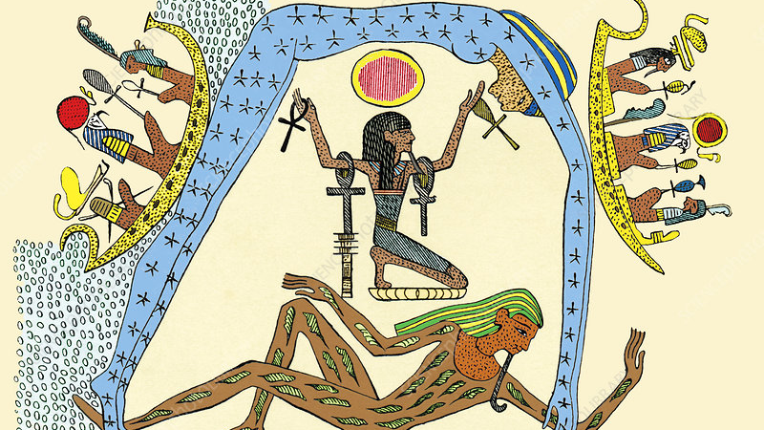
Notes:
Egyptian creation myth. 19th-century artwork of a story from the Egyptian creation myths from the third and second millennia BC. The Egyptians told the stories of creation as a series of births and cosmic battles between the gods. Shu the air god (centre) is raising Nut the sky goddess (blue, forming the arch of the sky) to separate her from Geb the earth god (across bottom). Nut is adorned with stars, while Geb is adorned with leaves. The sky, to the Egyptians, was a heavenly Nile, along which the boat of the sun-god Ra (upper left and upper right) sailed from east to west. Artwork from Pioneers of Science (Oliver Lodge, 1893).

Slide 28
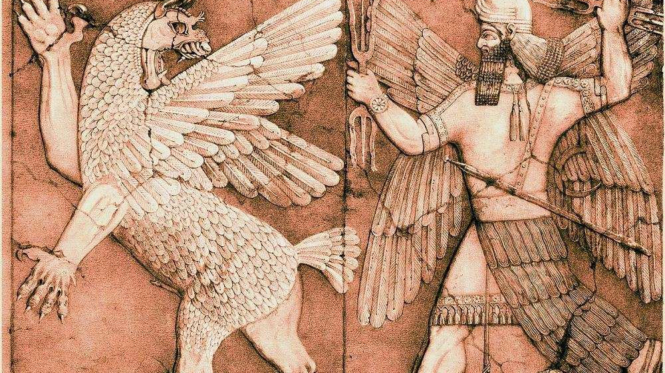
Notes:
WIKI Marduk battles a monster. Bas relief from a small temple in Nimrud. British Library.
The recitation of the Enuma Elish, “When of High,” better-named The Great Hymn of Marduk, tells about the creation of the world, and how Marduk saved the gods and thereby took his place as king.
The Enuma Elish and the Epic of Gilgamesh are two of the most significant literary masterpieces in Mesopotamian culture. Enuma Elish is a creation myth that covers the beginning of the cosmos as well as the origins of the gods, whereas the Epic of Gilgamesh is a story about a king's search for immortality.
BRITIANICA https://www.britannica.com/topic/Enuma-Elish
Enuma elish, ancient Mesopotamian creation epic that tells the tale of Marduk, the chief god of the city of Babylon. He defeats the elder goddess Tiamat and brings order to chaos and thus becomes the Lord of the Gods of Heaven and Earth.

Slide 29
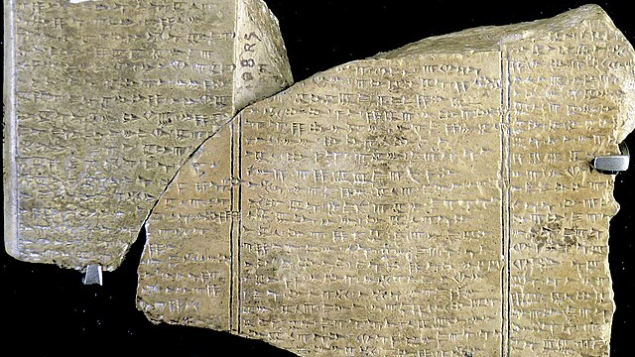
Notes:
Baal cycle tablets - In the mythology of Canaan, Baal, the god of life and fertility, locked in mortal combat with Mot, the god of death and sterility. If Baal triumphed, a seven-year cycle of fertility would ensue; but, if he were vanquished by Mot, seven years of drought and famine would ensue.

Slide 30
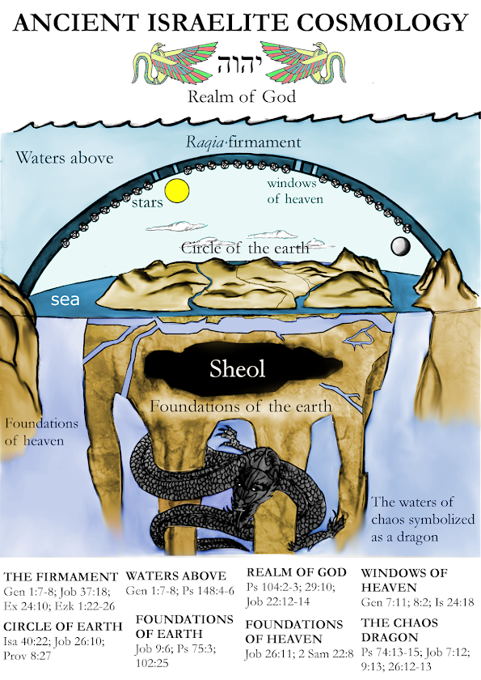
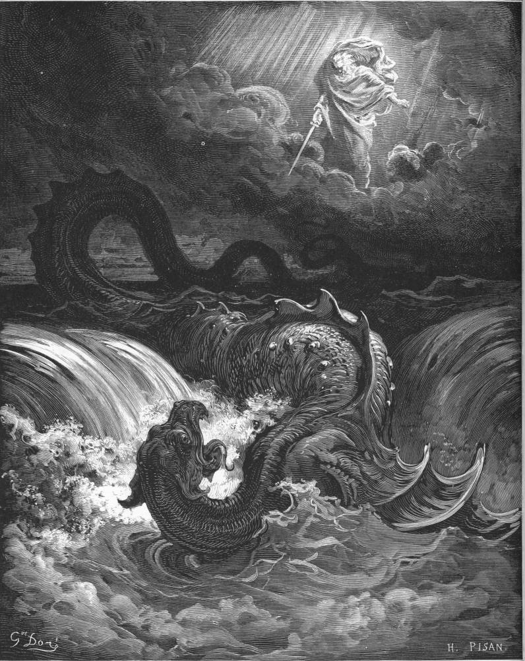
Ben Stanhope,
(Mis)interpreting Genesis:
How the Creation Museum
Misunderstands the
Ancient Near Eastern Context
of the Bible
(Scarab Press:
Louisville Kentucky, 2018), 88.
Notes:
The destruction of Leviathan
Gustave Doré (1832-83), artist
H. Pisan, engraver
1866
Source: The Holy Bible
“In that day the Lord with his sore and great and strong sword shall punish Leviathan the piercing serpent . . . and he shall slay the dragon that is in the sea” (Isaiah 27:1).

Slide 31
LECTURE THREE:
Creation of the Visible World
CREATION OF THE VISIBLE WORLD
The Genesis account does not ignore the mythology of Israel’s pagan neighbours.
  It incorporates elements from these stories in order to make strong theological points.
  God used familiar terms and ideas drawn from ancient cosmogony and cosmology in order to be understood by people who lived in those times.
  Genesis is a factual account but for obvious reasons not communicated in terms of 21st Century science.

Slide 32
LECTURE THREE:
Creation of the Visible World
CREATION OF THE VISIBLE WORLD
Order from chaos
  Most ancient creation stories begin with chaos and the battle between rival gods.
  The result is order coming out of primeval chaos.
  To see how this plays out in Genesis 1, we must understand the opening text.

Slide 33
LECTURE THREE:
Creation of the Visible World
CREATION OF THE VISIBLE WORLD
  Standing alone, as an Independent clause,
    Genesis 1:1 may be understood either as a heading, or title for what is to come. It introduces or summarises the whole creation account which follows.
    Or, it could be taken as the first act of creation. First, God created the heavens and the earth, then went on to activate the six days of creation that follow in the text.
    Is there another possibility?

Slide 34
LECTURE THREE:
Creation of the Visible World
CREATION OF THE VISIBLE WORLD
  Dependent clauses
    Hebrew grammar in Genesis 1:1-3 allows for dependent clauses, as translated in the English version of the Hebrew Scriptures (tanach) published by The Jerusalem Publication Society (JPS):
    ¹When God began to create heaven and earth — ²the earth being unformed and void, with darkness over the surface of the deep and a wind from God sweeping over the water — ³God said, "Let there be light"; and there was light. JPS

Slide 35
LECTURE THREE:
Creation of the Visible World
CREATION OF THE VISIBLE WORLD
  The Jerusalem Publication Society (JPS):
  1st Dependent Clause:
  Verse 1: When God began to create heaven and earth
  2nd Dependent Clause:
  Verse 2: the earth being unformed and void, with darkness over the surface of the deep and a wind from God sweeping over the water
  Main Clause:
  Verse 3: God said, "Let there be light"; and there was light.

Slide 36
LECTURE THREE:
Creation of the Visible World
CHAOS VERSUS ORDER
  Genesis 1:2 does not describe the absolute beginning of creation, but what God did to bring about the creation as we now know it.
  But the “chaos” of Genesis 1:2, is not the chaos of the pagan religions in the ANE.
  The description of God’s “chaos” is a polemic against paganism.

Slide 37
LECTURE THREE:
Creation of the Visible World
What we learn from Genesis creation narratives:
  God begins with the Genesis 1:2 state – empty, dark, unformed, a form of ‘chaos’, yet to be purposed
  He is in charge
  God is present. The wind (or Spirit) of God is moving over the surface of the waters
  God’s Word is absolute – “God said, ‘let there be light, and there was light’”
  This ‘chaos’ represents potential – the potential of a good and highly developed order.

Slide 38
LECTURE THREE:
Creation of the Visible World
SUMMARY
God created both the spiritual and the physical realms and populated each with different kinds of beings.
The spiritual/non-embodied beings lived in heaven and physical/embodied beings had earth as their place of abode.
The heavenly beings are called ʾelōhîm (gods) and the earthly beings are called ʾādhām, (humankind).

Slide 39
LECTURE THREE:
Creation of the Visible World
SUMMARY (Cont)
The ʾelōhîm are also called “the (heavenly) sons of God”, a familial or relational term.
ʾādhām, by implication refers to God’s earthly sons.
God has two families, one on earth and one in heaven, each with similar roles to fulfill, but within their respective spheres.
Later biblical revelation shows the significance of this in the greater plan of God (Hebrews 12:22).

Slide 40


APOSTOLIC AND PROPHETIC MINISTRY
Equipping you to equip others
www.colindye.com

Slide 41
The Hub Lectures 2024

Slide 42
THE CREATION
STORY
Supernatural Worldview

Slide 43
SERIES ONE: All Things Visible & Invisible
Programme: Saturday 17 February 2pm – 5.30pm (GMT)
(Live from 1.30pm)
    Lecture 4. Humanity and the Image of God
    (2.00pm – 2.50pm)
    Lecture 5. Male and Female in the Creation Story
      (3.00pm – 3.50pm)
    Lecture 6. Male and Female Identity
    (4.10pm – 5.00pm)
    Q & A
    (5.00pm – 5.30pm)

Slide 44
LECTURE FOUR:
Humanity and the Image of God
There are 3 main ways scholars have understood the Imago Dei.
  Substantive view – characteristics or qualities that God possesses and has specifically given to humanity.
  Relational view – the relational nature of God (inherent in his trinitarian nature) given to humanity in order that we can reflect his relational holiness to the world. Also, the capacity to form social relationships with the external created order and in particular with other humans.
  Functional view – the status or role God gave humans as his royal representatives on the earth.
Notes:
Relational-Social View

Slide 45
LECTURE FOUR:
Humanity and the Image of God
The image of God is the status God has given humanity as his vice-regents on the earth.
Genesis 1:26-28
²⁶Then God said, "Let us make man in our image, after our likeness. And let them have dominion over the fish of the sea and over the birds of the heavens and over the livestock and over all the earth and over every creeping thing that creeps on the earth.“ ²⁷So God created man in his own image, in the image of God he created him; male and female he created them. ²⁸And God blessed them. And God said to them, "Be fruitful and multiply and fill the earth and subdue it and have dominion over the fish of the sea and over the birds of the heavens and over every living thing that moves on the earth." ESV

Slide 46
LECTURE FOUR:
Humanity and the Image of God
“…Let us make man in our image, after our likeness…”
Who do these plurals refer to?
  Trinity? No. God does not have to inform himself, or the other members of the Trinity – they are co-eternal, co-equal and co-omniscient.
  Majesty? No. If God were merely referring to himself using the ‘royal we’, the plural of majesty, then to whom is he speaking? He is announcing his intention to someone or some others apart from himself.
  Heavenly or divine Council? More likely.

Slide 47
LECTURE FOUR:
Humanity and the Image of God
“Morning stars, sons of God”
Job 38:4-7
⁴"Where were you when I laid the foundation of the earth? Tell me, if you have understanding. ⁵Who determined its measurements—surely you know! Or who stretched the line upon it? ⁶On what were its bases sunk, or who laid its cornerstone, ⁷when the morning stars sang together and all the sons of God shouted for joy? ESV
In the OT, “morning stars”, “sons of God”, “holy ones”, “heavenly host”, “gods” (elohim), “armies of heaven”, all refer to the same spiritual beings, the heavenly sons of God.

Slide 48
LECTURE FOUR:
Humanity and the Image of God
Imagers of God
  The heavenly sons of God were given a family status and role as members of the divine council.
  They were created to assist God in his heavenly rulership and government.
  As divine council members they reflect God’s governorship of the cosmos.
Notes:
The members of the heavenly council act for, serve and assist God in his government of the heavens over the earth.

Slide 49
LECTURE FOUR:
Humanity and the Image of God
The divine council at work
1 Kings 22:19-21
¹⁹And Micaiah said, "Therefore hear the word of the Lord: I saw the Lord sitting on his throne, and all the host of heaven standing beside him on his right hand and on his left; ²⁰and the Lord said, 'Who will entice Ahab, that he may go up and fall at Ramoth-gilead?' And one said one thing, and another said another. ²¹Then a spirit came forward and stood before the Lord, saying, 'I will entice him.' ESV
  .

Slide 50
LECTURE FOUR:
Humanity and the Image of God
“Let us make man in our image, after our likeness” (Gen 1:26)
Just as God had a heavenly council charged with assisting him in the heavenly realms so now God announced the creation of earthly imagers, charged with the task of fulfilling his purposes on the earth.
“So, God created human beings in his own image…” (Gen 1:27)
The “so” refers to what has gone before. In Hebrew it is a ‘waw consecutive’ connecting verse 27 to verse 26. It means “and so”, that is, in fulfilment of God’s announcement to the sons of God

Slide 51
LECTURE FOUR:
Humanity and the Image of God
Image of God is a relational reality
  The metaphor, “sons of God” applies to the spiritual beings, God’s heavenly family, who assist him in the rule of the heavens over the earth.
  It also applies to the human sons God created to represent his government on the earth.
  As image-bearers humanity’s role is to reflect God’s relational nature and character in the world and to extend his kingdom into all the earth.
  God’s plan is to bring the two families of heaven and earth together (as it was in Eden) in the final, global, cosmic manifestation of his Kingdom.
Notes:
HEISER “Created in the image of God, means to be created for a purpose, to participate with God to complete the tasks assigned to us. In the fallen world, only the redeemed can do this effectively or fully.”

Slide 52
LECTURE FOUR:
Humanity and the Image of God
SUMMARY
The image of God in humanity is a status, not a set of attributes. God’s imagers are his partners and representatives. But this function has a relational context. We are created to be in fellowship with God. Our imaging can only be successful in intimate and obedient relationship with him.
The family metaphor, “sons of God”, first used of the heavenly beings, is now applied to the new earthly family of God. God’s ultimate purpose is the unite both families under his government and in his presence for eternity
Notes:
NOTE: here is a good place to expand on the “substantive view” of the image of God – the abilities or properties given to humans thar reflect the communicable attributes of God shared with humanity

Slide 53
LECTURE FIVE:
Male and Female in the Creation Story
IDENTITY COMES BEFORE ROLE
Most theological discussion about male and female focusses on the roles of men and women – marriage, family, church, wider society. There are two main theological views.
  Egalitarianism – emphasises the equality of the sexes and teaches the family, the church and society at large should make no distinction on what positions women hold, jobs they can perform or roles they can fulfil.
  Complementarianism – acknowledges that men and women are equal in dignity and worth, but their roles differ in the various spheres, especially in the family and in the church.

Slide 54
LECTURE FIVE:
Male and Female in the Creation Story
IDENTITY COMES BEFORE ROLE
Any discussion about male and female roles must begin with male and female identity. What do masculinity (being male) and femininity (being female) mean? Is there a biblical answer?
  “Masculinity and femininity are part of our distinctive identity as gendered image bearers”.
    Larry Crabb Fully Alive: A Biblical Vision of Gender That Frees Men and Women to Live beyond Stereotypes
Notes:
See Larry Crabb quote in NOTES on page 24

Slide 55
LECTURE FIVE:
Male and Female in the Creation Story
MALE AND FEMALE IDENTITY IN THE BIBLE
First creation account
Male זָכָר (zākār) and Female נְקֵבָה (nĕqēbâ)
  Genesis 1:26-28
  ²⁶Then God said, "Let us make man in our image, after our likeness. And let them have dominion over the fish of the sea and over the birds of the heavens and over the livestock and over all the earth and over every creeping thing that creeps on the earth." ²⁷So God created man in his own image, in the image of God he created him; male and female he created them.
  ²⁸And God blessed them. And God said to them, "Be fruitful and multiply and fill the earth and subdue it and have dominion over the fish of the sea and over the birds of the heavens and over every living thing that moves on the earth." ESV
  Genesis 1:27
  So God created man in his own image, in the image of God he created him; male and female he created them.

Slide 56
LECTURE FIVE:
Male and Female in the Creation Story
MALE AND FEMALE IDENTITY IN THE BIBLE
First creation account
Genesis 1:26-28 Analysis of the text
Verse 26: Then God said, "Let us make man in our image, after our likeness. And let them have dominion
Men and women are God’s joint representatives on earth and have a dominion mandate.
Verse 27: Male and female he created them
Two sexes (genders) a binary biological and theological reality.
Notes:
Binary Biology: Male and Female. Intersex is a biological anomaly. DSD or CCSD – Differences in sexual development; Congenital Conditions of Sexual Development. These are about the anatomical variations with males and within females – uphold the dimorphic nature of the human species – male and female, defined by the gametes required for sexual reproduction.
It is very rare category within the biological binary (note some changes in the classification of intersex can exaggerate the stats) and is an anomaly. No third sex. Intersex is rare, and most often it is clear what the biological sex is – very rarely are the genitalia totally ambiguous. Assigning one’s gender at birth, which is almost without necessity from a medical point of view, is a social decision and has become now a political issue – even to the point of denying biological science, demonizing those who recognise that a person’s biological sex cannot be changed and attempting to rewrite the texts books on the subject.
Humans: Males produce small gametes (sperm) and females produce larger gametes called eggs. There is no human case of a person being able to create both male and female gametes. This is a fundamental and unchangeable biological reality. Anomalies do not contradict the binary nature of human sexual biology – intersex, sterility etc.

Slide 57
LECTURE FIVE:
Male and Female in the Creation Story
MALE AND FEMALE IDENTITY IN THE BIBLE
First creation account
Genesis 1:26-28 Analysis of the text (cont)
Verse 28:
And God blessed them – the mandate is preceded by relational blessing
And God said to them – God’s spoken word ( “and God said, let there be…”)
Be fruitful and multiply and fill the earth – procreation is at the heart of the relational mandate and fundamental to the male/female distinction
And subdue it – a ‘kingdom’ mandate
Have dominion – over the natural world
Notes:
Procreation is at the heart of the Creation Mandate (male and female biological distinction). Here biology and theology come together. Unlike modern culture that separates Gender (Psychology) of Sex (Biology)
Gender dysphoria
Damage of Trans-agenda on children and society. Gender Ideology, not Gender Biology
See Matt Walsh “What is a woman?” See The Intersex Gambit by Paradox Institute Zachary Elliott

Slide 58
LECTURE FIVE:
Male and Female in the Creation Story
First creation account
Key points:
The human race exists in one genus or kind – humankind אָדָם (ʾādām)
It exists in two forms – male זָכָר (zākār) and female נְקֵבָה (nĕqēbâ)
  Both equally carry God's image and both are equal in dignity and worth
  Both have an equal part to play in the creation mandate but bring their distinctiveness into the partnership
  Identity as male and female precedes role or function
  Relationship is fundamental in the creation of humanity – God, marriage (male and female), family and community.
  The Creation Mandate begins and continues with God’s blessing.

Slide 59
LECTURE FIVE:
Male and Female in the Creation Story
Second Creation Account
Man אִיש (ʾîš,) and Woman אִשָּׁה (ʾiš·šāhʹ)
Genesis chapter 2 gives us a second account of creation. God adds some key perspectives concerning the identity and roles of men and women.
Genesis 2:18
Then the Lord God said, "It is not good that the man should be alone; I will make him a helper fit for [corresponding to] him." ESV

Slide 60
LECTURE FIVE:
Male and Female in the Creation Story
Second Creation Account
Man אִיש (ʾîš,) and Woman אִשָּׁה (ʾiš·šāhʹ)
Genesis 2:23-24
²³Then the man said, "This at last is bone of my bones and flesh of my flesh; she shall be called Woman, because she was taken out of Man." ²⁴Therefore a man shall leave his father and his mother and hold fast to his wife, and they shall become one flesh. ESV

Slide 61
LECTURE FIVE:
Male and Female in the Creation Story
Second Creation Account
Man אִיש (ʾîš,) and Woman אִשָּׁה (ʾiš·šāhʹ)
Textual points from Genesis 2:23:
At last (“this time”) – no suitable helper for Adam had been found among the animals
This is bone of my bone and flesh of my flesh – Eve was formed from Adam’s side.
She shall be called Woman, because she was taken out of Man – the Hebrew word for woman אִשָּׁה (ʾiš·šāhʹ) sounds like the Hebrew word for man אִיש (ʾîš,) .

Slide 62
LECTURE SIX:
Male and Female Identity
Biblical words for ‘male’ and ‘female’
Genesis 1:27 (Hebrew)
‘Male’ in Hebrew is זָכָר (zākār) and ‘female’ is נְקֵבָה (nĕqēbâ).
Mark 10:6 (Greek)
‘Male’ in Greek is ἄρσην (arsēn) and female is θῆλυς (thēlys).
Both the Hebrew and Greek words point to the fundamental identity of male and female, what it means to be masculine or feminine.

Slide 63
LECTURE SIX:
Male and Female Identity
Biblical words for ‘male’ and ‘female’
The Theological Dictionary of the Old Testament:
The noun zākhār occurs 82 times in the OT and indicates the male sex of a species of both men and animals.
The etymology of zākhār is obscure; we can conjecture that the root conception is “be sharp, pointed.”
A connection with the root zkr, “mention, name, remember,” has often been conjectured, but this remains obscure and unsupported.
The derivation of neqēbhāh from the root nqb, “bore, pierce,” understood in a sexual reference, is reasonably clear.

Slide 64
LECTURE SIX:
Male and Female Identity
Biblical words for ‘male’ and ‘female’
James Swanson, Dictionary of Biblical Languages:
(zkr)
זָכַר (zā·ḵǎr): v. Str 2142; TWOT 551
LN 29.6–29.12 (qal) remember, i.e., to recall information or events (2Ki 9:25); (nif) remembered (Eze 33:13);
2. LN 29.16–29.18 (qal) remember, i.e., to recall information or events, with a focus on responding in an appropriate manner (Ex 6:5)

Slide 65
LECTURE SIX:
Male and Female Identity
“male” and “female” - ἄρσην (arsēn); θῆλυς (thēlys)
According to Strong, (arsēn) means “male” (as stronger for lifting)
This physical reality sets the tone for the broader attribution of a certain kind of strength which is linked to the male identity.
He also shows the derivation of “female” (thēlys) linked to the breast/nipple and (by implication) to suck.
This sets the tone for the female identity, showing the nurturing nature of the female.

Slide 66
LECTURE SIX:
Male and Female Identity
These OT & NT words help us begin to formulate a biblical understanding of what it means to be male/masculine or female/feminine.
Male:
  Hebrew: “to be sharp, pointed”
  Greek: “stronger for lifting”
Female:
  Hebrew: “bored, pierced”
  Greek: “breast, providing nurture”

Slide 67
LECTURE SIX:
Male and Female Identity
These OT & NT words help us begin to formulate a biblical understanding of what it means to be male/masculine or female/feminine.
Male:
  Hebrew: “to be sharp, pointed”
  Greek: “stronger for lifting”
Female:
  Hebrew: “bored, pierced”
  Greek: “breast, providing nurture”
Notes:
The beginning point is the meaning/derivation of the Greek and Hebrew words. But this is just the start – more study is needed to see how male and female are viewed in the Biblical narrative, and specific teaching on the subject up to and including the NT. The objective of this series of studies is to focus on the supernatural realm, and with regards to male and female, how the supernatural being corrupted human sexual identity and exploited the differences in order to deceive Eve and to entice Adam to fail as a man (ie the man).

Slide 68
LECTURE SIX:
Male and Female Identity
Crabb in Fully Alive puts it this way/
Relational femininity is a way of relating that both invites life-giving connection from another and nourishes life-giving relating in another. (Page 66)
Arsen, Greek for male, means “to lift, to carry.” It points to the strength needed to move something from one place to another. Together, arsen and zakar suggest the beginning idea that a man reflects God by remembering what is important and moving into a disordered situation with the strength to make an important difference. (Page 68)

Slide 69
LECTURE SIX:
Male and Female Identity
A brief word about roles
A key point found in Genesis 2:18 is that the woman was created to be the helper to the man. This shows that there is a certain priority in the role of the man. He is to be the loving leader. The woman is gifted as the responsive helper.
Notes:
We will examine this a little more when look at Gen 3 – the first divine-human rebellion.

Slide 70
LECTURE SIX:
Male and Female Identity
Summary
There's a gap, an incompleteness in man without woman and a corresponding incompleteness in woman without the man.
Woman was made to be a helper to the man.
The man has a certain priority role of (headship).
Femininity: “a way of relating that both invites life-giving connection from another and nourishes life-giving relating in another” (Crabb).
Masculinity: “a man reflects God by remembering what is important and moving into a disordered situation with the strength to make an important difference” (Crabb).
Notes:
This study is looking at the meaning of the words male, female and man, woman – focusing on identity. This can point us in certain direction concerning roles – but we must go on to do further study to examine biblical evidence and examples of roles and how they arise from or are influenced by these fundamental male and female identities – that’s another study.

Slide 71
APOSTOLIC AND PROPHETIC MINISTRY
Equipping you to equip others
www.colindye.com

Slide 72
All Things Visible & Invisible
IN PERSON
Benefit from: classroom interaction, Q & A, printed materials, powerpoints, free video download.
Register now: SERIES ONE on Eventbrite,
ALL THINGS VISIBLE & INVISIBLE
ONLY £30.00* (plus £3.22 Event Fee).
*Registration automatically includes both Saturdays.
ONLINE
Join us online Free!
Facebook colindye.org
YouTube ColinDyeOnline
Instagram colin_dye_official

Slide 73

THE CREATION
STORY
Supernatural Worldview

Slide 74
COMPLETE THE COURSE!
(VENUE TBC)
SERIES TWO
(25 MAY & 1 JUN 2024)
Divine and Human Rebellions
Genesis 3 Adam and Eve and the Nachash
Genesis 6 The sons of God and the daughters of man
Genesis 11 The Babel story
Deuteronomy 32 Handing over the nations and the call of Abram
SERIES THREE
(28 SEP & 5 OCT 2024)
The Spiritual World
Psalm 82 and the divine council
Satan, angels and demons
Principalities and powers
The angels who sinned

